Slide 1
PROJECT TITLE :UPLIFTING THE FARMER THROUGH CONNECTED ECOSYSTEMS
PIP104 University Project-II
Review-1
Batch Number: 32
Roll Number | Student Name
20211CSE0760 | ShriNidhi
20211CSE0780 | Prathish S
20211CSE0742 | Thasmay H P
20211CSE0683 | Akash D
Under the Supervision of,
Assistant Professor Ms.Dhanya
School of Computer Science & Engineering
Presidency University

Slide 2
Introduction
Centralized Farming Portal: The web portal provides essential information for farmers and aggregators, such as where to buy seeds, pesticides, fertilizers, and where to sell crops.
Business Expansion & Support: Farmers can purchase machinery, secure loans, and expand their activities, while aggregators can grow their business through the platform.
Multi-User Access: General users can buy crops, and the portal offers simultaneous multi-user access with data management from any location or device.
Role-Based Access: The system includes role-based authentication, restricting access to specific sections based on user roles, ensuring security and data consistency.

Slide 3
Literature Review
The "Uplifting the Farmer Through Connected Ecosystems" project highlights how digital agriculture, IoT, and smart farming can improve agricultural productivity and sustainability. Digital technologies enable real-time monitoring and data-driven decision-making, with IoT-based sensors and facilitating precision agriculture by optimizing water, fertilizer, and pesticide use (Wolfert et al., 2017; Kamilaris et al., 2017).
Smart farming incorporates AI, robotics, and IoT to address resource scarcity and environmental challenges, while precision agriculture fine-tunes crop management for higher yields and lower costs (Fountas et al., 2020). This can significantly enhance farmer livelihoods by reducing input costs and increasing market access (Ferroni & Zhou, 2012).
However, barriers exist for smallholder farmers, including high costs, limited digital literacy, and infrastructure challenges (Aker & Mbiti, 2010). Successful projects like Kenya's M-Farm and India's Digital Green demonstrate the potential of mobile technologies in connecting farmers to markets and information (Dey & Pradhan, 2019).

Slide 4
Proposed Method
The study assesses farmers' awareness and demand for ecosystem services, providing policy suggestions to improve this awareness. Policymakers can use these insights to support sustainable development in immigration areas, meeting farmers' needs while promoting environmental and socioeconomic stability.
Farmer’s awareness of ecosystem services is related to their personal elements and a series of socioeconomic factors. Individual awareness of core ecosystem services in Village was divided into three levels according to the survey results: low awareness (aware of three to 5 core ecosystem services); medium awareness (aware of six to 8 core ecosystem services); and high awareness (aware of 9 to eleven core ecosystem services).

Slide 5
Objectives
Enhance Agricultural Productivity: Leverage connected ecosystems to improve farmers’ access to real-time data, enabling precision farming, better crop management, and optimized resource use (e.g., water, fertilizers).
Facilitate Market Access: Develop digital platforms that connect farmers directly with buyers, reducing intermediaries and ensuring better pricing, transparency, and fair trade practices.
Promote Financial Inclusion: Integrate financial services into the ecosystem, providing farmers access to credit, insurance, and digital payment systems, ensuring financial stability and security.
Empower Farmers through Technology: Improve digital literacy and adoption of IoT, AI, mobile applications, and blockchain technologies to enhance decision-making and operational efficiency.

Slide 6
Methodology
Data Collection:
Gather data from various sources such as farmer surveys, interviews, and existing agricultural datasets (e.g., crop yields, weather data, market prices).
Technology Selection:
Identify appropriate technologies for the connected ecosystem, including IoT devices (sensors), mobile applications, blockchain platforms, and data analytics tools.
Prototype Development:
Build a prototype of the connected ecosystem, integrating selected technologies.
Training the Machine Learning Models:
Utilize collected datasets to train machine learning models for predictive analytics (e.g., yield forecasting, resource optimization).
Software and Hardware Requirements:
Software:
Python 3.x for data analysis and machine learning model development.
IDEs such as Jupyter or PyCharm for coding and testing.
Cloud platforms (e.g., AWS, Google Cloud) for data storage and processing.

Slide 7
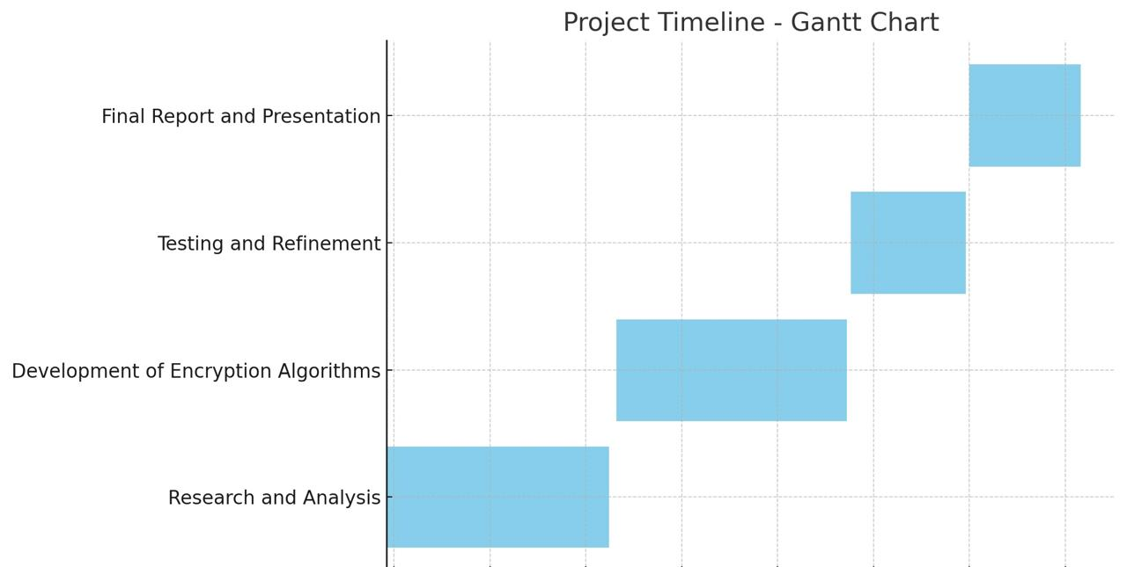
Timeline of Project
Dec (2024)
Nov (2024)
Oct – Nov (2024)
Development
Sep – Oct (2024)

Slide 8
Expected Outcomes
24/7 Availability: The connected ecosystem will provide farmers with round-the-clock access to resources, information, and support, ensuring they can seek assistance with agricultural inquiries or market conditions at any time.
Enhanced Farmer Engagement: By offering personalized recommendations and interactive features, the ecosystem will foster greater engagement among farmers, encouraging them to utilize digital tools for better decision-making and resource management.
Increased Efficiency for Stakeholders: Automation of routine tasks, such as data collection and market price updates, will reduce the workload for agricultural extension workers and other stakeholders, allowing them to concentrate on more strategic and complex issues within the farming community.
Data-Driven Insights: The ecosystem will generate valuable data from farmer interactions, providing insights into their needs, challenges, and preferences. This information will enable the institution and partners to make informed improvements to services, educational content, and support mechanisms.

Slide 9
Conclusion
A new way of approach for better understanding of farming practices are being employed by the farmers. The proposed system solves their problems related to lack of data about the farming and its facilities.
The proposed system is simple and easy, also it is a better way to guide farmer to assist them to lift both socially similarly as economically knowing to their betterment of future.

Slide 10
References
An Intelligent College Enquiry Bot Using NLP and Deep Learning-Based Techniques. (2022). – IEEE Xplore.
https://ieeexplore.ieee.org/abstract/document/9725865/
AI and Machine Learning Based E-Learning System for Secondary Education. (2022). – IEEE Xplore.
https://ieeexplore.ieee.org/abstract/document/9824643/
AI and Web-Based Interactive College Enquiry Chatbot. (2021). – IEEE Xplore.
https://ieeexplore.ieee.org/abstract/document/9515065/
CSM: A Chatbot Solution to Manage Student Questions About Payments and Enrollment in University. (2024). – IEEE Xplore.
https://ieeexplore.ieee.org/abstract/document/10536871/
Deep Learning-Based Campus Assistive Chatbot. (2021). – IEEE Xplore.
https://ieeexplore.ieee.org/abstract/document/9683551/

Slide 11
Thank You

